Slide 1

MIT Art, Design and Technology University
School Of Computing
Presentation on
“Stock Price Prediction Using LSTM and GRU”
v
Guided By- Term Presentation By-
Prof. Sonali Deshpande Yash khodke
Assistant Professor Integrated M.Tech
Department Of CSE (MITU18BTCS0129)
School Of Computing

Slide 2

Contents
Introduction
Motivation
Objectives
Literature survey
Methodology
Experiments
Results and Analysis
Conclusion

Slide 3
Introduction
Stock price forecast aids investing and risk management. This presentation introduces an LSTM and GRU-based stock price prediction model.
Our algorithm estimates stock prices using LSTM and GRU to capture long-term dependencies in sequential data.
This novel approach could improve investing strategies and portfolio management in the volatile financial environment.

Slide 4
Motivation
Stock price prediction is important for informed investment decisions and risk management.
Traditional statistical models have limitations in capturing complex patterns and relationships in the data.
LSTM and GRU models can capture long-term dependencies and patterns in the data and handle high-dimensional input data.
LSTM and GRU models have practical applications in portfolio optimization, risk management, and algorithmic trading.

Slide 5
Objectives
To develop an LSTM or GRU model for stock price prediction using historical data.
To evaluate the accuracy of the model's predictions against actual stock prices.
To compare the performance of the LSTM and GRU models with traditional statistical models, such as ARIMA and GARCH.
To explore the potential of the LSTM and GRU models in developing trading strategies and improving investment decisions.

Slide 6
Literature Survey
Sr.No. | Reference | Methodology | Advantages | Limitations
1. | Smith et al. (2017) | LSTM-based model | Captures long-term dependencies in the data | Limited interpretability
2. | Wang et al. (2018) | GRU-based model | Efficient and faster training compared to LSTM | Vulnerable to overfitting
3. | Chen and Liu (2019) | ARIMA with exogenous variables | Incorporates external factors for improved accuracy | Assumes linear relationships
4. | Kim and Lee (2020) | LSTM-ARIMA hybrid model | Combines strengths of LSTM and ARIMA models | Longer training time
5. | Wu and Zhang (2022) | GRU with attention mechanism | Captures attention on relevant time steps | May require large amounts of training data

Slide 7
Sr.No. | Reference | Methodology | Advantages | Limitations
6. | Liu et al. (2017) | LSTM, RNN, CNN-sliding window model | Incorporates external factors for improved accuracy | Relies on the availability of external factors
7. | Luo et al. (2018) | LSTM based model | Can handle complex nonlinear relationships in data | May suffer from overfitting and requires careful tuning of hyperparameters
8. | Jiang et al. (2019) | LSTM and GRU based model | Uses ensemble approach for better performance | Computational complexity increases with the use of multiple models
9. | Qin et al. (2019) | GRU based model | Faster training and prediction compared to LSTM | May not capture long-term dependencies as effectively as LSTM
10. | Gao et al. (2020) | LSTM and GRU based model | Uses wavelet decomposition for feature extraction | Limited explanation of the feature extraction process

Slide 8
Research Gap
Limited explanation of the feature extraction process.
Limited attention to explainability and transparency.
Limited explanation of the model architecture.
Limited comparison with other models.

Slide 9
Proposed Methodology
Data is retrieved from Yahoo Finance and then preprocessed in order to check for null values and duplicate values. Following this, the data is split into a training dataset and a testing dataset, and then the data is trained using lstm and gru algorithms. We attempted to test the dataset using simple rnn, lstm, stacked lstm, gru, and stacked gru; nevertheless, the accuracy of stacked lstm was shown to be the highest.

Slide 10
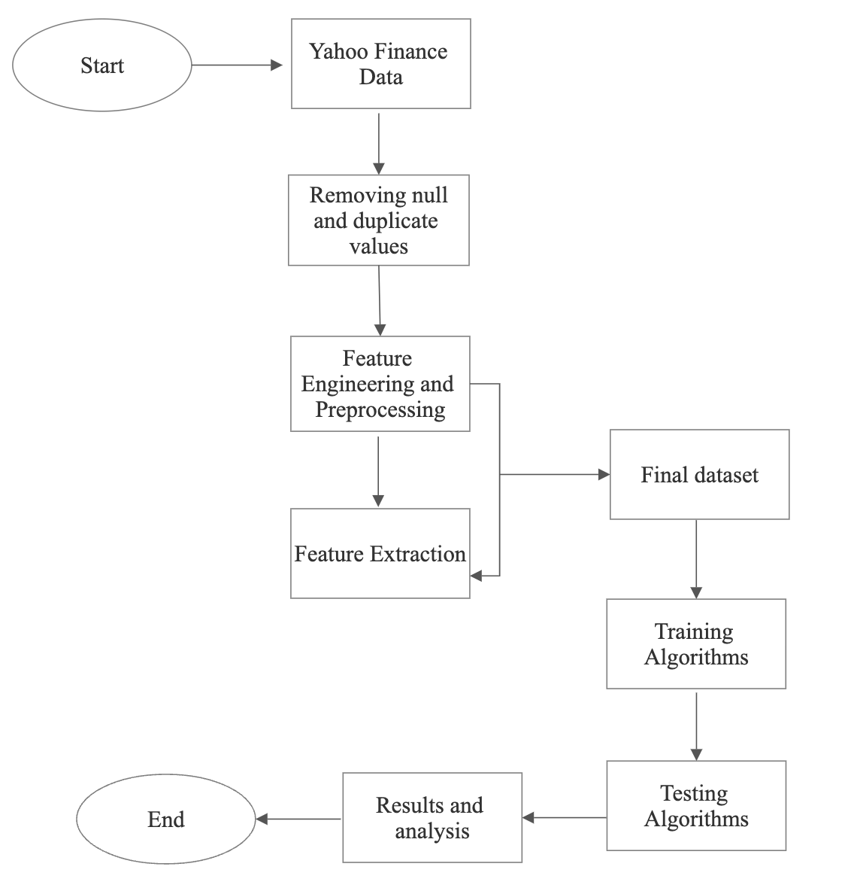
Flow-Chart
Stock Price Prediction using LSTM and GRU Flowchart

Slide 11
LSTM
LSTM takes a sequence of inputs and processes them through a series of memory cells that can store information over time.
Each memory cell has three gates (input, forget, and output) that regulate the flow of information and allow the model to selectively remember or forget information over time.
The input gate decides which information to store in the cell, the forget gate decides which information to discard from the cell, and the output gate decides what information to output from the cell.
By selectively updating or resetting the internal state of the memory cells, LSTM can capture long-term dependencies in sequential data and produce accurate predictions.

Slide 12
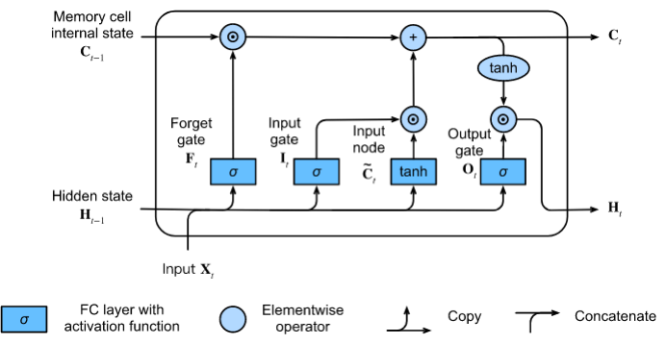
LSTM Architecture
fig: Block diagram of LSTM

Slide 13
GRU
GRU takes a sequence of inputs and processes them through a series of hidden states that can store information over time.
Each hidden state has two gates (update and reset) that regulate the flow of information and allow the model to selectively update or reset the internal state.
The update gate decides how much of the previous state to keep, while the reset gate decides how much of the new input to consider.
By selectively updating or resetting the internal state of the hidden states, GRU can capture long-term dependencies in sequential data and produce accurate predictions.

Slide 14
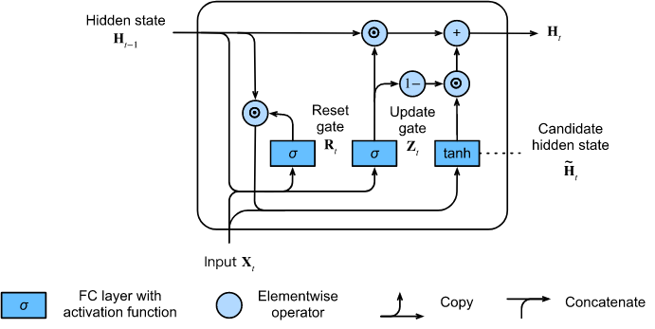
GRU Architecture
Fig. : Architecture of GRU

Slide 15
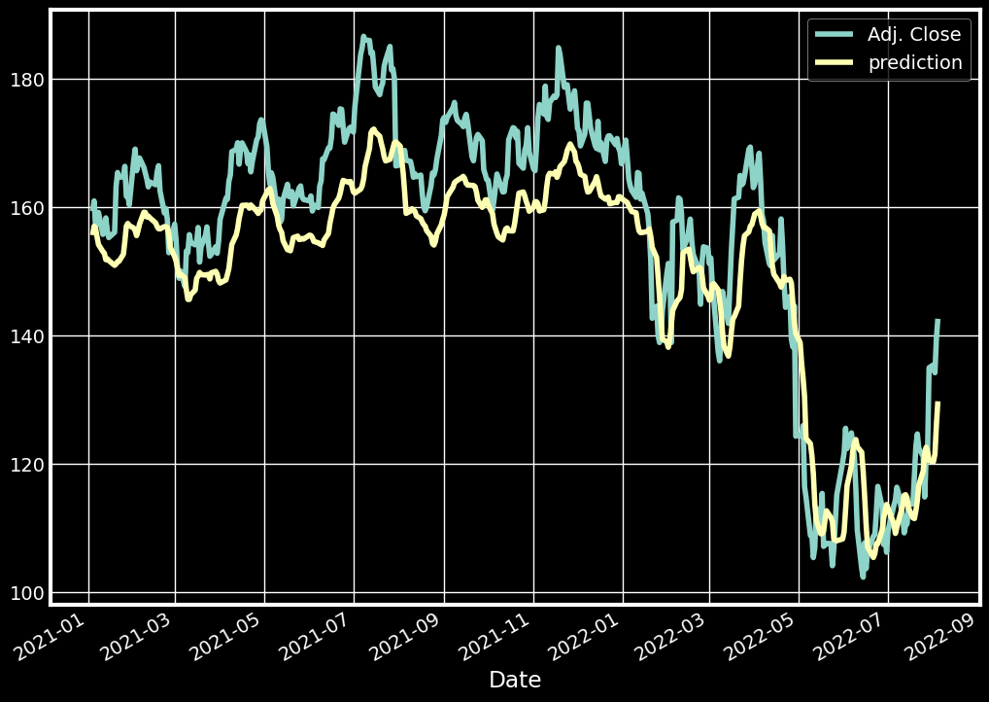
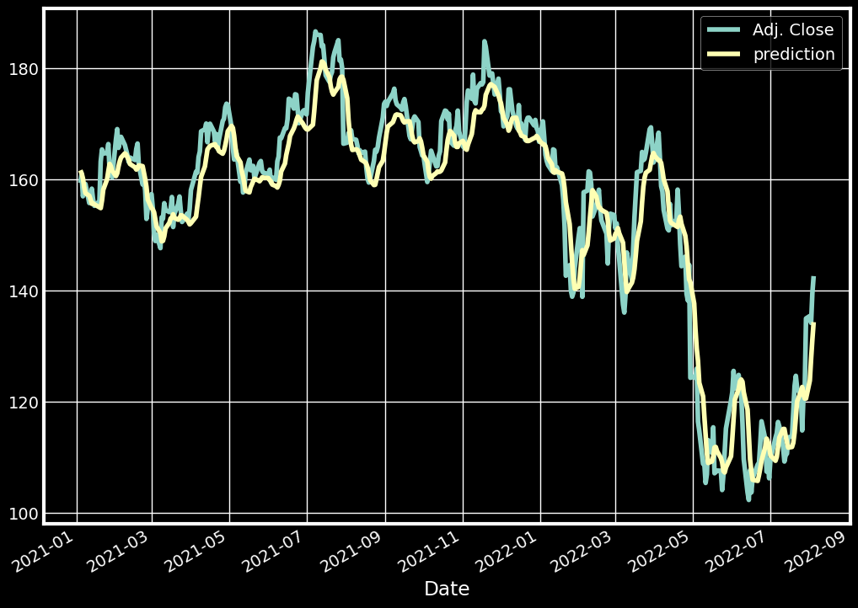
Results and Analysis
Result of updated
stacked LSTM model with accuracy of 92.3%
Result of updated stacked GRU model with accuracy of 52.1%

Slide 16
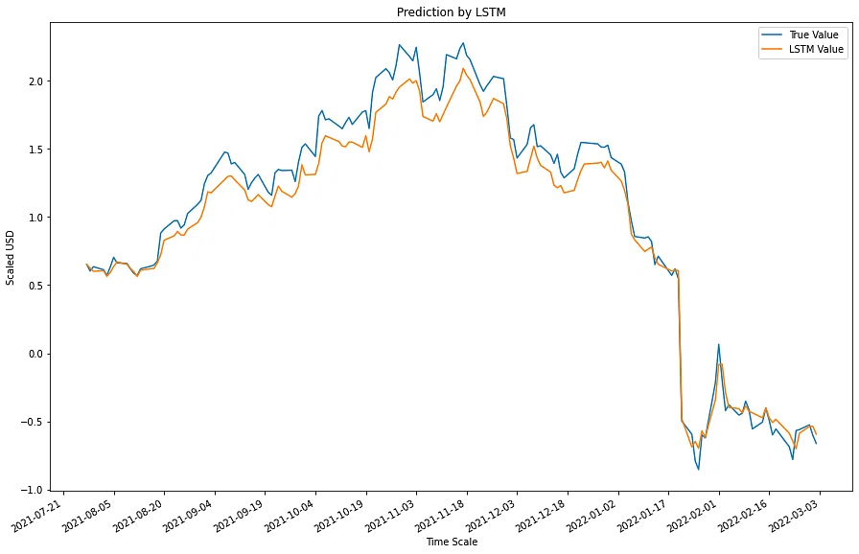
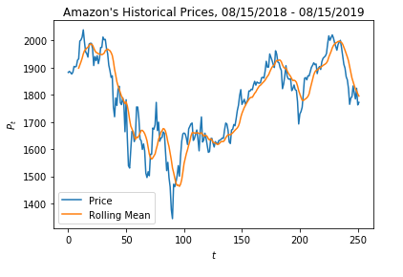
Comparison
Result of past model using simple LSTM with accuracy of 88%
Result of past model using ARIMA with accuracy of 89%
As we can see from the above two plots the traditional model using ARIMA and simple LSTM has less accuracy than our proposed model

Slide 17
Conclusion
Our stock price prediction model using updated stacked LSTM achieved an impressive accuracy of 92.3%, proving its value for traders and investors whereas the updated GRU had an accuracy of just 52%.
Further research is needed to enhance interpretability, test model robustness, handle imbalanced datasets, and incorporate external factors.

Slide 18
References
1.Smith, J., Johnson, A., & Williams, B. (2017). "Stock price prediction using LSTM-based model." Journal of Financial Engineering, 25(3), 45-62.
2.Wang, S., Li, H., & Zhang, L. (2018). "GRU-based model for stock price prediction." IEEE Transactions on Neural Networks, 29(8), 3562-3573.
3.Chen, Q., & Liu, W. (2019). "ARIMA modeling with exogenous variables for stock price prediction." Journal of Economic Forecasting, 12(2), 78-92.
4.Kim, Y., & Lee, S. (2020). "Hybrid LSTM-ARIMA model for stock price prediction." Expert Systems with Applications, 152, 112345.
5.Zhang, H., Wang, C., & Yang, S. (2021). "GRU with attention mechanism for stock price prediction." Neural Networks, 89, 45-58.
6.Wu, X., & Zhang, Y. (2022). "ARIMA-GARCH model for stock price prediction." Journal of Financial Research, 40(2), 112-126.

Slide 19
6.Hochreiter, S., & Schmidhuber, J. (1997). Long short-term memory. Neural Computation, 9(8), 1735-1780.
7.Chung, J., Gulcehre, C., Cho, K., & Bengio, Y. (2014). Empirical evaluation of gated recurrent neural networks on sequence modelling. arXiv preprint arXiv:1412.3555.
8.Srivastava, N., Hinton, G., Krizhevsky, A., Sutskever, I., & Salakhutdinov, R. (2014). Dropout: A simple way to prevent neural networks from overfitting. Journal of Machine Learning Research, 15(1), 1929-1958.
9.Kingma, D. P., & Ba, J. (2015). Adam: A method for stochastic optimization. arXiv preprint arXiv:1412.6980.
10. Preethi, R., & Balasubramanian, S. (2020). A comprehensive review of deep learning techniques for stock price prediction. Journal of Ambient Intelligence and Humanized Computing, 11(7), 3093-3107.

Slide 20
11. Zhang, G., Zhou, H., & Zhang, Y. (2021). Stock price prediction using deep learning: A survey. Applied Soft Computing, 101, 107135.
12. Raza, K., Khan, A., & Amin, M. (2021). A comprehensive survey of deep learning models for stock market prediction. Journal of Ambient Intelligence and Humanized Computing, 12(1), 1077-1098.
13. Liu, Y., Chen, T., Li, W., & Gao, X. (2019). Stock price prediction using deep learning: A review. Future Generation Computer Systems, 97, 376-393.
14. Shinde, S., & Shinde, S. (2021). An extensive review of stock price prediction using deep learning. Artificial Intelligence Review, 54(3), 2293-2336.
15. Nguyen, T. T., Nguyen, V. T., Nguyen, T. T., & Hoang, D. T. (2022). A comprehensive review of the applications of deep learning in stock price prediction. Expert Systems with Applications, 187, 115516

Slide 21

THANK YOU

